Slide 1
Module 7: Recording, reporting and use of TB data
Notes:
Welcome to Module 7 on Recording, reporting and use of TB data.

Slide 2
Learning Objectives
Recognise the registers and reports used in child and adolescent TB.
Identify indicators to be used to monitor and evaluate child and adolescent TB.
Understand the importance of local use of routinely available TB data to improve quality of TB case finding and management among children and adolescents.
Notes:
By the end of this module, you will be able to:
Recognise the registers and reports used in child and adolescent TB.
Identify indicators to be used to monitor and evaluate child and adolescent TB
Understand the importance of local use of the routinely available TB data to improve quality of TB case finding and management among children and adolescents.

Slide 3
Outline
Registers and reports used in TB management
Indicators used to monitor and evaluate child and adolescent TB
Local use of routinely available TB data to improve quality of TB case finding and management among children and adolescents
Exercise
Conclusion
Challenge your knowledge
Notes:
I have arranged this module as follows:
We’ll start by a review of the registers and reports that most national TB programmes use.
Then we’ll have a look at the indicators used globally and in our programmes to monitor and evaluate child and adolescent TB.
We’ll cover basics of local use of routinely available TB data to improve quality of TB case finding and management among children and adolescents both at a facility and district levels.
An exercise and a summary of key learning points will conclude this module.

Slide 4
Outline
Discussion
Registers and reports used in TB management
Indicators used to monitor and evaluate child and adolescent TB
Local use of routinely available TB data to improve quality of TB case finding and management among children and adolescents
Exercise
Conclusion
Challenge your knowledge
Discussion
Notes:
We want to hear from you and will pause, discuss and share briefly our country- and setting-specific experiences in recording and reporting with a focus on child and adolescent TB.

Slide 5
Discussion on setting-specific practices

Slide 6
Discussion: Recording & reporting in child and adolescent TB management
How are TB data compiled and reported to the district-provincial-national levels in your setting? Who is responsible? Is it paper-based or electronic or both? Do you use DHIS2?
1
What are the key strengths and challenges in recording and reporting of child and adolescent TB?
2
What age groups are used for TB reporting in your setting?
3

Slide 7
How are TB data compiled and reported to the district-provincial-national levels in your setting? Who is responsible? Is it paper-based or electronic or both? Do you use DHIS2?
1
What are the key strengths and challenges in recording and reporting of child and adolescent TB?
2
What age groups are used for TB reporting in your setting?
3

Slide 8
Registers and reports used in TB management

Slide 9
TB registers
ADULT & CHILD
ADAPT TO LOCAL SETTING
Presumptive TB Register
TB Laboratory Register
Facility and District TB Register
TB Preventive Treatment Register
Contact Management Register
Electronic recording tools
Notes:
Information on children and adolescents being evaluated and treated for both TB and TB infection is integrated into the national recording and reporting tools used by the NTP. They include presumptive TB, laboratory, facility and district TB registers. The more recent additions are contact management and TPT registers. Most NTPs have also standardised forms for laboratory requests and results and TB patient identity and treatment cards.
To ease reporting and ensure completeness of medical records, some countries have introduced electronic and case-based recording tools.
Let’s now have a look at these tools in more detail.

Slide 10
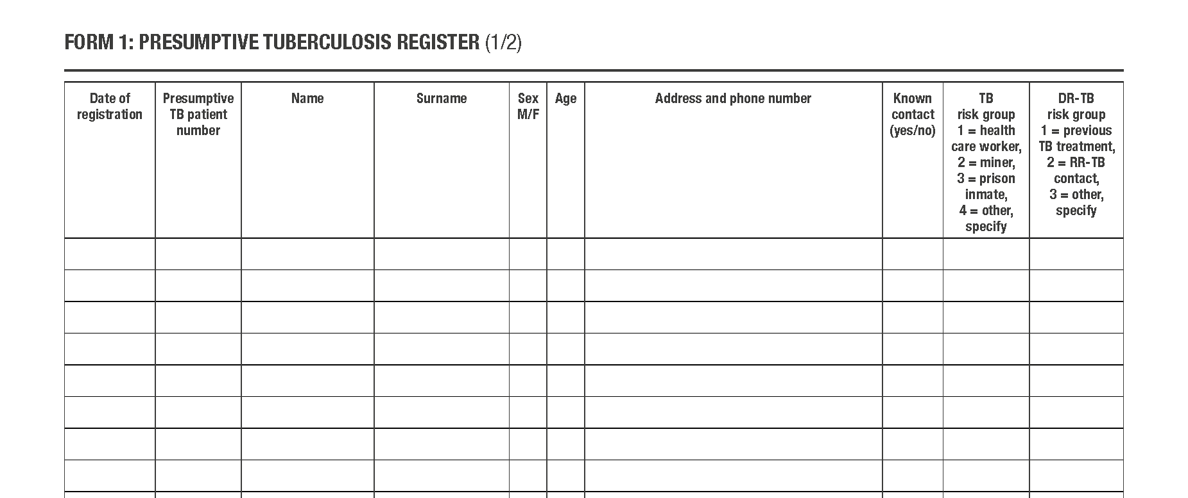
Presumptive TB register
ADULT & CHILD
ADAPT TO LOCAL SETTING
Patient demographics
Known contact
HIV
status
Started on Rx
Specimen information
Source: Management of Tuberculosis: A Guide to Essential Practice. The Union; 2019.
Notes:
Each entry and care point where children or adolescents are attended to and screened for TB should have a presumptive TB register.
The presumptive TB register enables healthcare workers to track all those with symptoms and signs, that is, with presumptive TB through the diagnostic cascade.
In addition to patient demographics, the register contains information on the care point to which they presented, HIV status, diagnostic specimen provided and whether a TB diagnosis was made and if so, whether the child or adolescent was started on TB treatment. Please pay particular attention to the section on ‘Specimen information’: you can see that a mere tick about sample collection is not enough!
In settings where HIV infection drives TB, HIV test result, should be included according to the WHO guidelines (2012) that recommend provider-initiated testing and counselling for all persons with presumptive TB.
This register enables healthcare workers to i) assess quality of the diagnostic cascade, that is, whether all the required steps have been completed and where gaps that require attention may be and ii) contact children and adolescents whose TB test results are received after they have left the health facility to ensure that they are initiated on appropriate treatment. This is a way to reduce pre-diagnosis and pre-treatment loss to follow-up.
Does your country use a presumptive TB register?

Slide 11
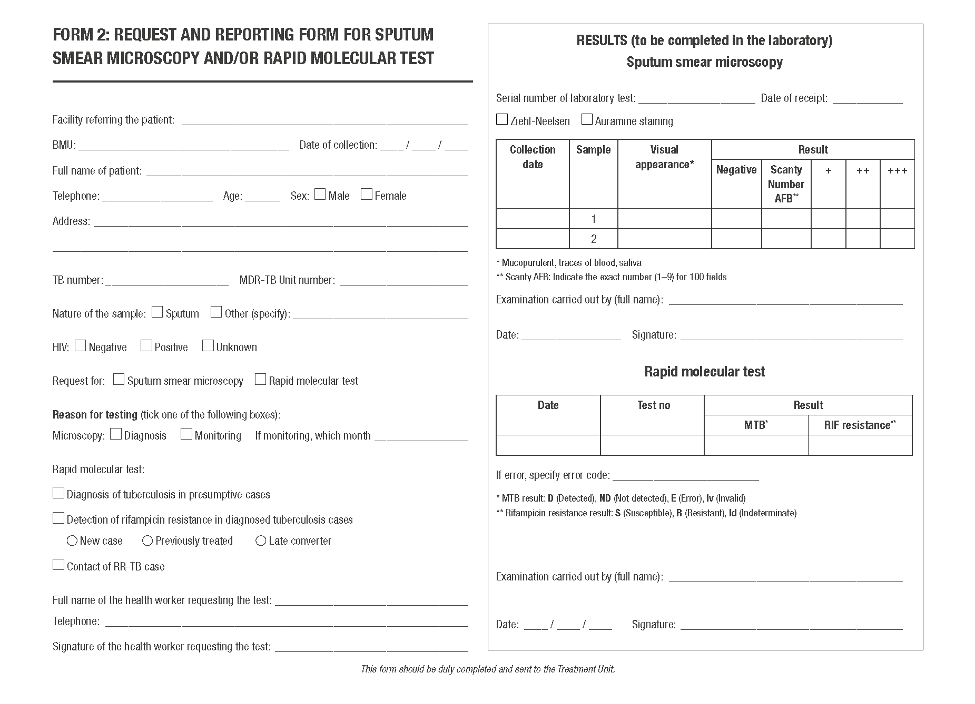
TB laboratory request and result form
ADULT & CHILD
ADAPT TO LOCAL SETTING
Sputum smear microscopy results
Patient demographics
Specimen
Laboratory staff details
HIV status
Test requested
Rapid molecular test results
Reason for testing
Health worker details
Laboratory staff details
Notes:
For every child and adolescent with presumptive TB, including those found during community-based screening interventions, e.g., active TB case-finding or contact screening, every effort should be made to get a bacteriological confirmation for TB.
The request for bacteriological confirmation in the laboratory is documented in the laboratory request and report form which contains the child’s name, age, sex, parents’ phone number, the type of specimen provided., the test requested and details of the healthcare worker. Results from testing are written in the second column of this form and include whether the test if negative or positive and in the case of GeneXpert testing, if rifampicin resistance is present or not.

Slide 12
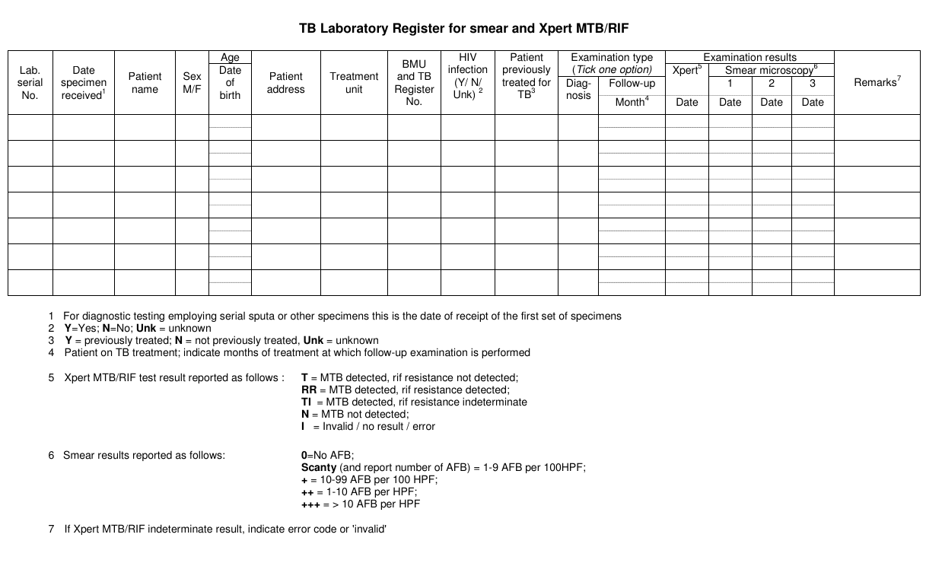
TB laboratory register
ADULT & CHILD
ADAPT TO LOCAL SETTING
Lab details
Patient demographics
HIV
status
Xpert
results
Smear microscopy results
Source: Global laboratory initiative. The handbook, Global edition. Adelaide: SA Pathology; 2013. 88p.
Notes:
To keep a record of all the sample specimens that have been received and tested, laboratory staff transcribe data from the laboratory request and report form into the TB laboratory register. This register contains the laboratory serial number, the date the specimen has been received and the patient’s demographic details (name, age, sex, treatment unit). It also contains some clinical details, e.g., the patient’s HIV status and whether they were previously treated for TB or not. Results from the examination and the date that these results are available are also recorded in the register.
Children and adolescents from whom sputum is collected to monitor response to TB treatment should also be recorded in the TB laboratory register. The type of examination (for follow-up and month) should be filled in appropriately.

Slide 13
Discussion: Presumptive TB and TB laboratory registers
Why do we need both presumptive TB and TB laboratory registers?
Notes:
If time allows this question can be posed in a mini-discussion among people sitting near each other, especially in countries where NTPs do not have a presumptive TB register (this register may be known with another name, e.g., cough register). If time is tight, the facilitator can ask for responses from the audience.
The answer is: the TB laboratory register captures the details of only those persons whose specimens reach the laboratory.
All specimens are not collected and even if they are collected, they may not reach the laboratory. This can be a major challenge, especially in situations where the laboratory is not situated at the facility where the person with presumed TB is evaluated and where specimen transportation is required. Having a presumptive TB register enables healthcare workers and TB coordinators to assess the diagnostic cascade and calculate the magnitude of pre-diagnosis loss to follow-up.
What proportion of children and adolescents with presumptive TB were ‘lost’ in your setting in the last month or quarter? What are the time trends, for example, in the past year of pre-diagnostic loss to follow-up in your setting?
Comparing the names and other details of people with a bacteriological confirmation in the TB laboratory register with the information in the TB register enables us to calculate the proportion of people who are not started on treatment. This is called pre-treatment loss to follow-up. Some operational research (Tollefson, D.; Ngari, F.; Mwakala, M.; et al. Int J Tuberc Lung Dis 2016; 20(10): 1334-1341) has reported that up to 20% or one in five people with presumed TB found with confirmed TB are not initiated on treatment. What is this proportion in your setting?

Slide 14
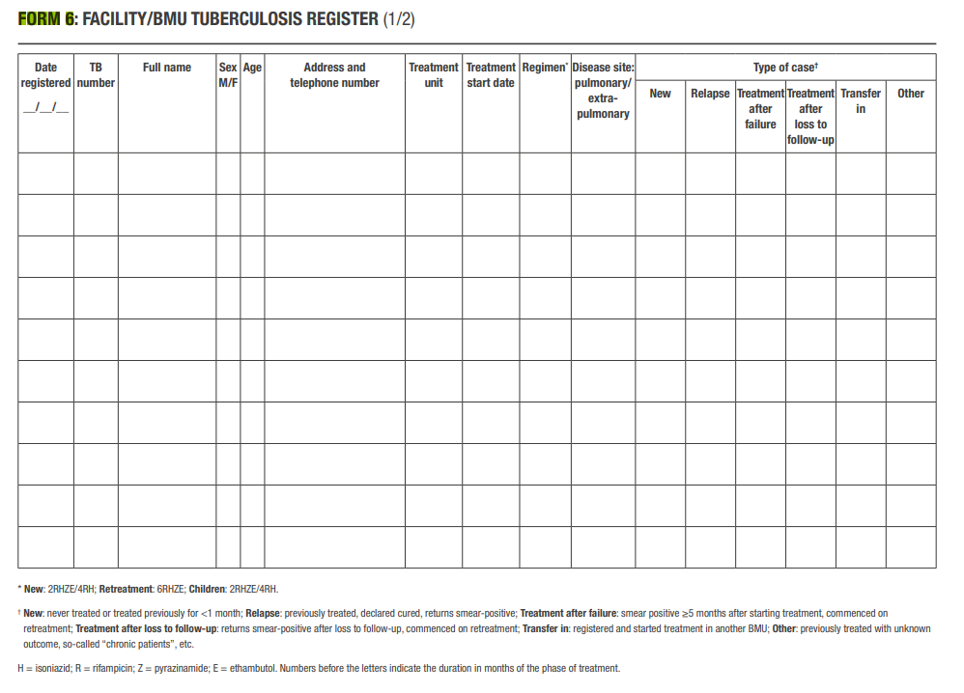
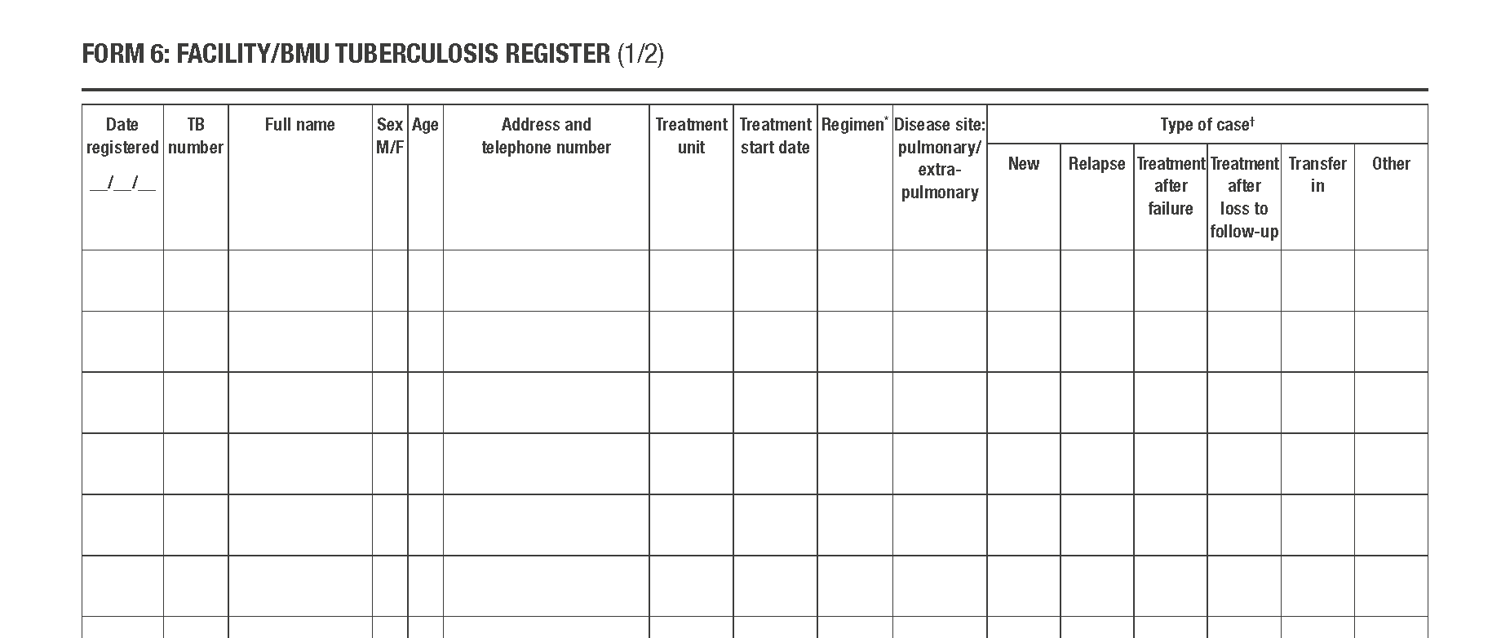
TB register
ADULT & CHILD
ADAPT TO LOCAL SETTING
Patient demographics
Rx details
Site
Category
Lab results
Rx outcome
HIV
Source: Management of Tuberculosis: A Guide to Essential Practice. The Union; 2019.
Notes:
All children and adolescents initiated on TB treatment should be registered in the TB facility register.
The TB facility register contains
Demographic information
Type of TB by disease site, history of previous treatment and whether bacteriologically confirmed or clinically diagnosed.
Treatment details, such as when regimen and the date the treatment was started.
HIV-related indicators, such as HIV status, CPT and ART.
Results of follow-up sputum examinations for children and adolescents with bacteriologically confirmed disease
the TB treatment outcome.
Districts should also have TB registers that include information for all persons on TB treatment within a district. These days paper-based registers are rapidly been replaced by electronic tools or DHIS2 from secondary level of health services upwards.

Slide 15
TB treatment outcome definitions
Outcome | Definition
Cured | A pulmonary TB patient with bacteriologically confirmed TB at the beginning of treatment who completed treatment as recommended by the national policy with evidence of bacteriological response and no evidence of failure
Treatment completed | A person with TB disease who completed treatment as recommended by the national policy whose outcome does not meet the definition for cure or treatment failure
Treatment successful | A person with TB disease who was either cured or who completed treatment as defined above
Treatment failed | A person with TB disease whose treatment regimen needed to be terminated or permanently changed to a new regimen or treatment strategy.
Died | Death from any reason before starting or during the course of treatment.
Lost to follow-up | Either did not start treatment or treatment was interrupted for two consecutive months or more.
Not evaluated | A person with TB to whom no treatment outcome was assigned, excluding those lost to follow-up.
Notes:
Listed here are the current WHO definitions for outcomes for treatment of TB.
They are similar for all TB patients irrespective of age and same for drug-susceptible or drug-resistant TB.
Most treatment success in children is recorded as treatment completed as cure cannot usually be established.
The main negative outcome in children or adolescents is LTFU which is why the emphasis on treatment support is important. Most will feel much better, gain weight and have symptom resolution within two months of starting treatment but it is important to emphasise that completion of the full course is required to reduce risk of relapse or resistance development.

Slide 16
Contact screening register
ADULT & CHILD
ADAPT TO LOCAL SETTING
Index patient details
Index patient treatment & outcome details
Contact demographics
Symptom check
Source: Uganda NTLP Contact Tracing Register
Notes:
Household contacts of all children or adolescents with drug-susceptible or drug-resistant TB should be screened and their details should be recorded in the contact screening register. This register enables healthcare workers to follow management of these contacts.
The register contains some information about the index patient including their name, type of TB, HIV status and progress on TB treatment. It also contacts information about demographic information about each contact and their relationship to the index patients. Finally, it includes information on whether or not they have symptoms and signs of TB, whether or not they receive a diagnostic test for TB or TB infection and whether or not they have started on TB treatment –if diagnosed with TB. This registers also shows if contacts in whom TB has been ruled out have been initiated on TB preventive treatment.

Slide 17
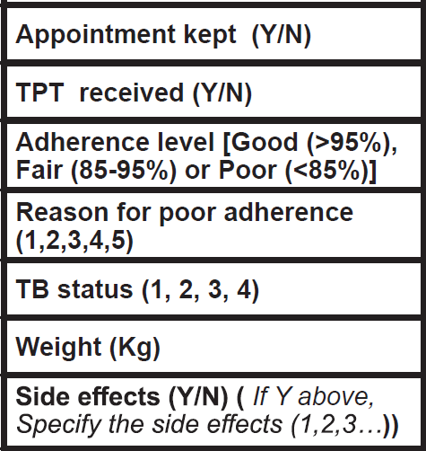
TB preventive treatment register
ADULT & CHILD
ADAPT TO LOCAL SETTING
Weight
Contact details
TPT initiation
TPT regimen
End of first 2 weeks of TPT treatment (adherence, weight, side effects)
Source: Uganda NTLP TB preventive therapy (TPT) register, 2019.
Notes:
Any contact who has been initiated on TB preventive treatment should be recorded in the TB preventive treatment register. The TB preventive treatment or TPT register contains the demographic details of the person taking TPT, the TPT regimen and the date that the treatment was started.
[CLICK FOR ANIMATION]….At each return visit,………. [CLICK FOR ANIMATION]

Slide 18
TB preventive treatment register
ADULT & CHILD
ADAPT TO LOCAL SETTING
Weight
Contact details
TPT initiation
TPT regimen
End of first 2 weeks of TPT treatment (adherence, weight, side effects)
Source: Uganda NTLP TB preventive therapy (TPT) register, 2019.
Notes:
……the healthcare workers assess for and record the following
adherence to TPT and reasons for non-adherence ( if any),
any adverse events
signs and symptoms of TB. and TPT outcome.
The outcome of TPT treatment ( whether the patient completed treatment, died, was lost to follow-up, stopped TPT plus the reasons for stopping) is also recorded in this registers.

Slide 19
Programme indicators for contact screening and TPT
Coverage of contact investigation:
Number (%) contacts screened/number of contacts of index cases identified
Number (%) contacts with active TB
Number (%) contacts eligible for TPT
TPT initiation: number (%) initiated/number of contacts eligible for TPT
Record TPT outcomes:
Treatment complete - Treatment discontinued
Loss to follow-up - Death - Not evaluated
TPT completed: number (%) treatment completed/number initiated TPT
Notes:
Important programmatic TPT indicators are
1) coverage of contact investigation,
2) TPT initiation of those without active TB and who are eligible for TPT
3) the proportion who complete TPT of those who initiated.
These data should be available to report from registers and can be presented as a cascade of care. The main reason for not completing is loss to follow-up.

Slide 20
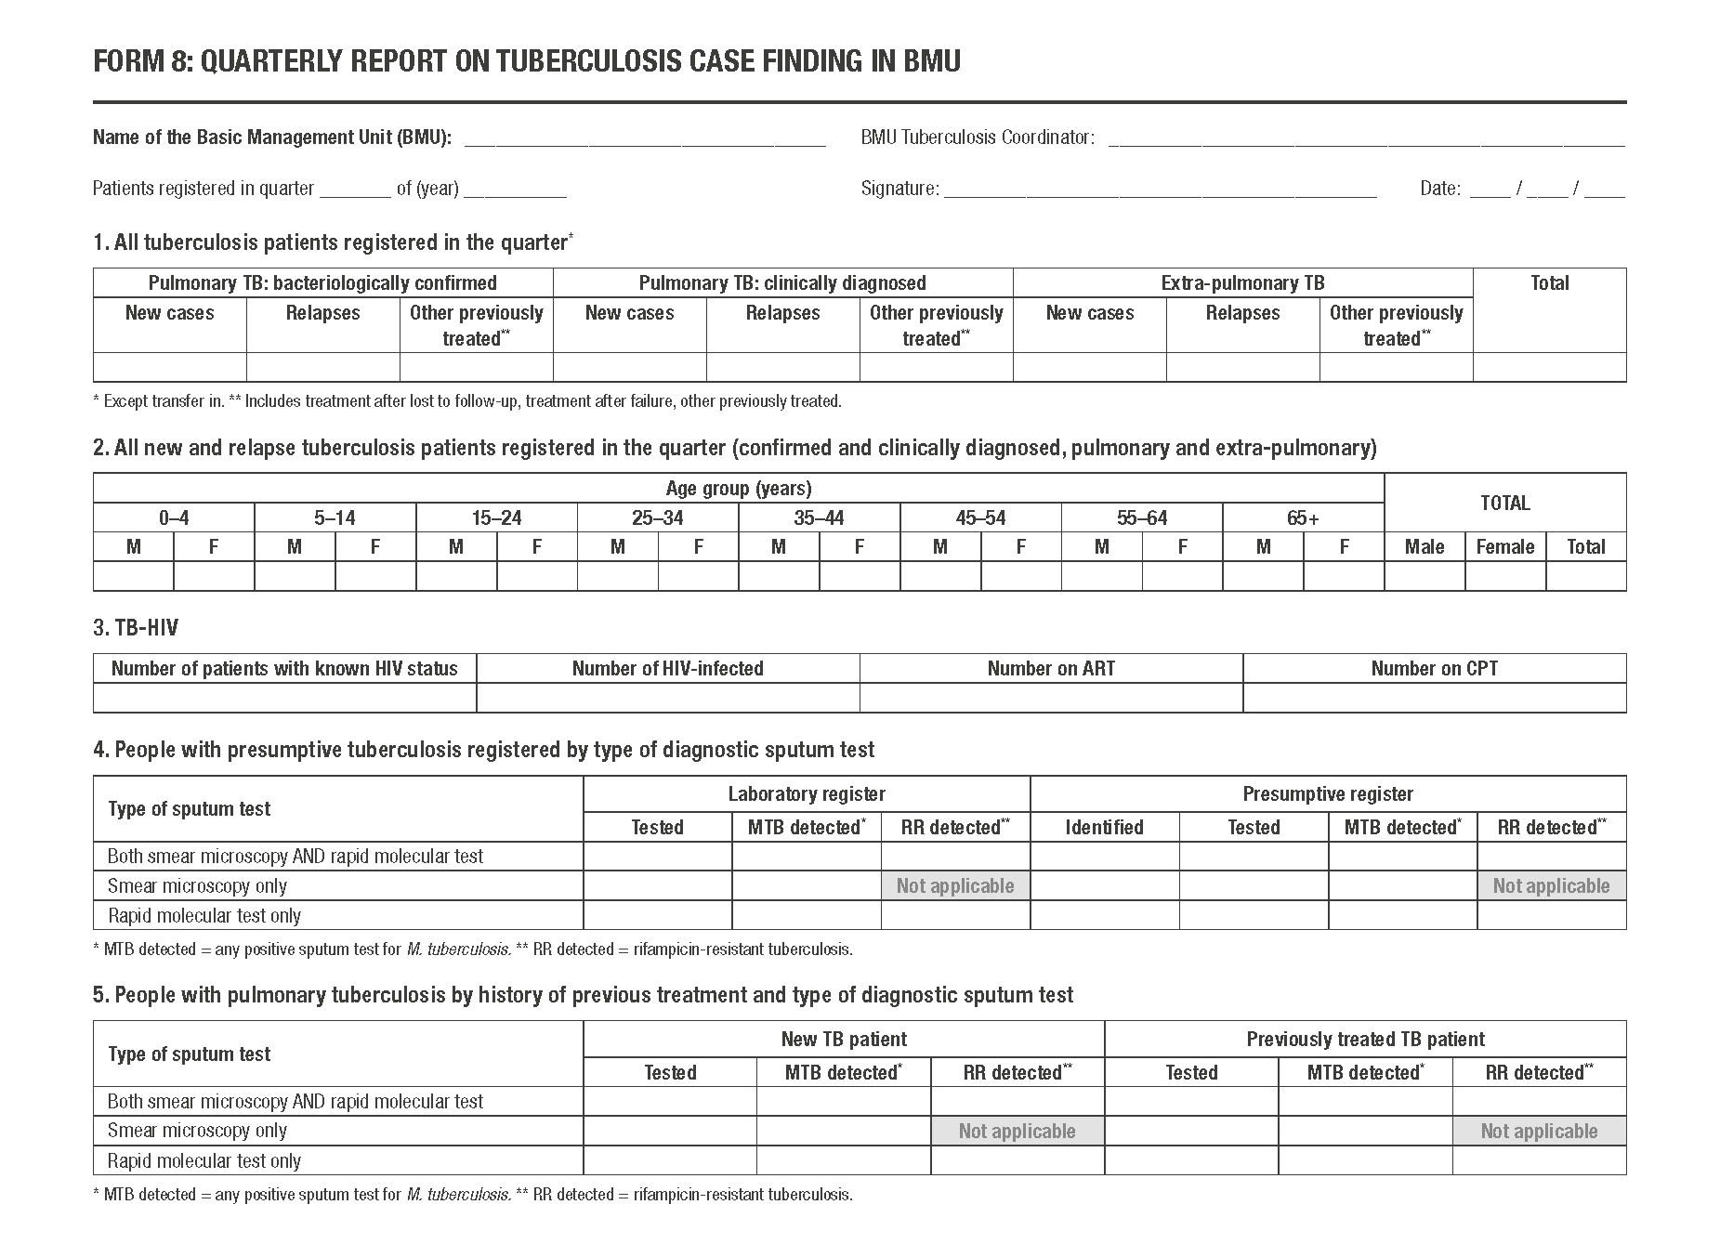
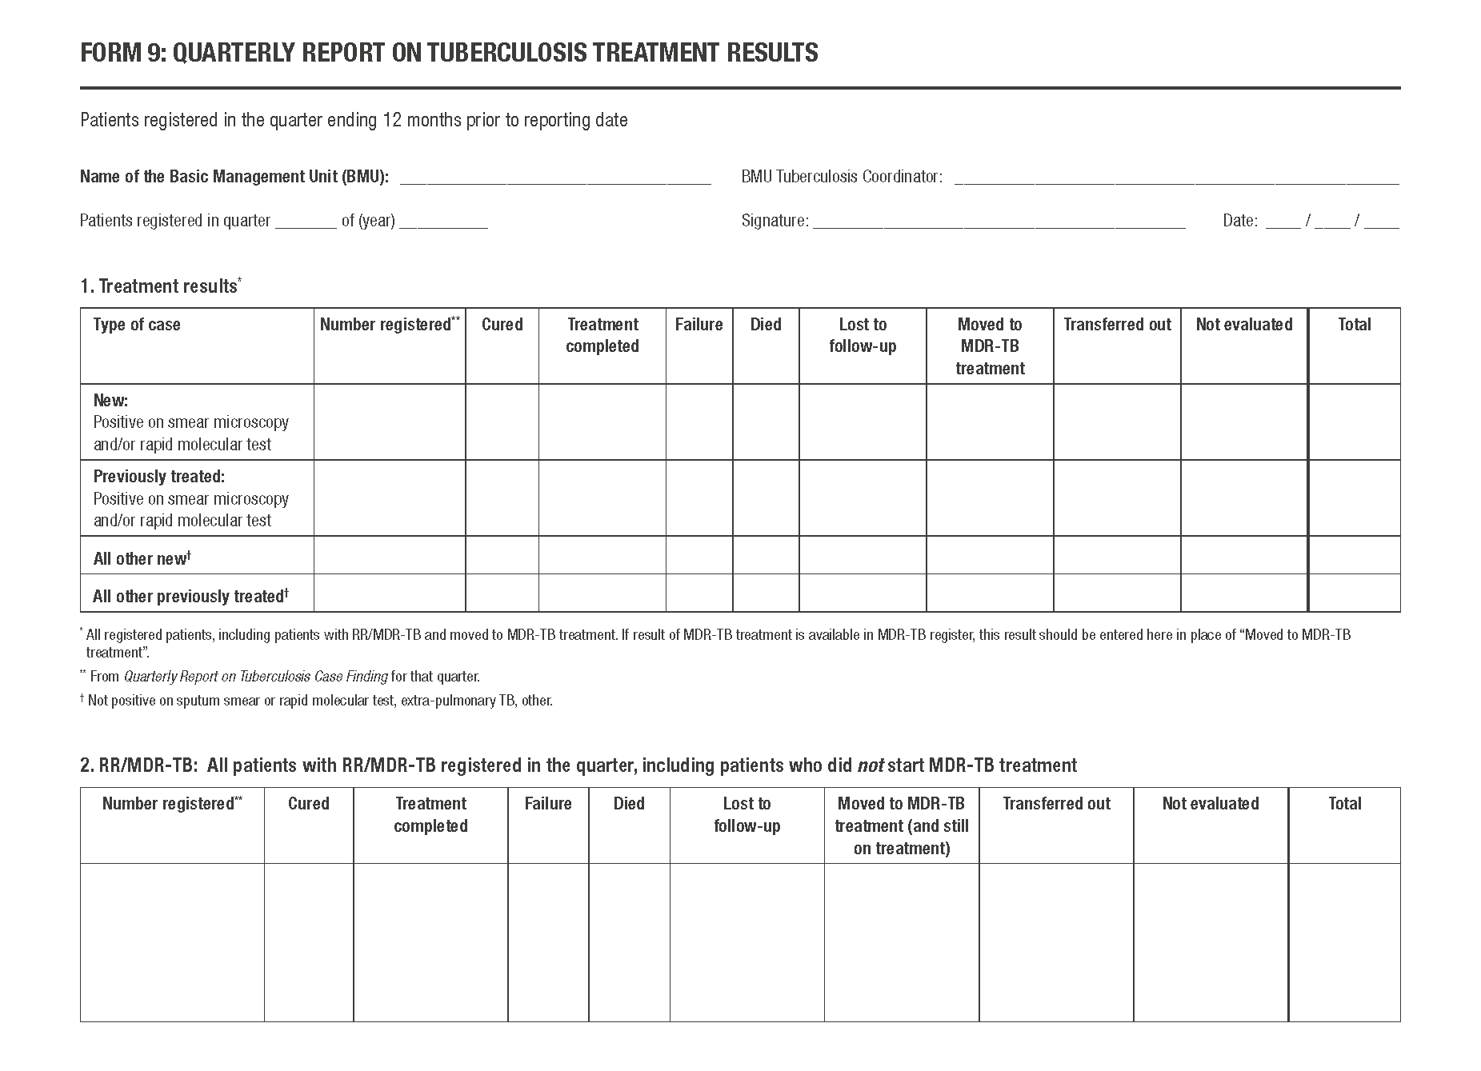
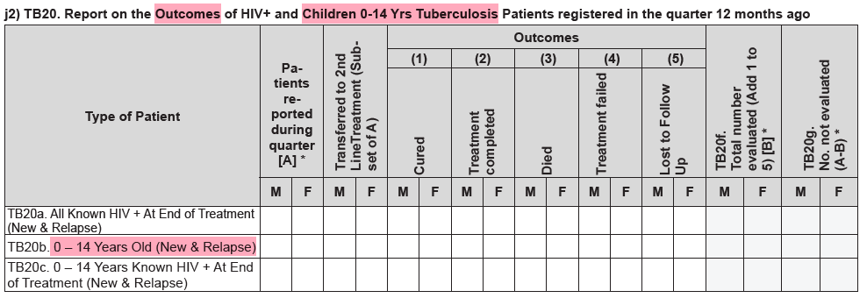
Quarterly reports
ADULT & CHILD
ADAPT TO LOCAL SETTING
Source: Management of Tuberculosis: A Guide to Essential Practice. The Union; 2019.
Notes:
Most national TB programmes prepare quarterly or monthly reports for TB case finding (notifications) and TB treatment outcomes that are reported for the cohort of patients who started their treatment in the same quarter or month one year earlier.
This slide presents a sample of a standard quarterly report template.
If you use quarters, they are as follows: the 1st quarter from January to March, the 2nd quarter from April to June, the 3rd quarter from July to September and the 4th quarter from October to December.
The first part is for the quarterly case notification report that reports all people registered with TB. They are disaggregated by site of disease and bacteriological confirmation or clinical diagnosis and by history of previous treatment. An age and sex disaggregation is also included. The quarterly report also captures the yield of bacteriological tests among people with presumptive TB, the proportion of persons with TB with a known HIV status, the proportion who were found to be HIV-infected, and of these, the proportion started on antiretroviral treatment and cotrimoxazole prophylaxis.
The second part covers TB treatment outcomes that are reported separately for new and retreatment cases with bacteriological confirmation and drug-susceptible disease and persons with drug-resistant disease. Persons who were transferred in from another health facility should be excluded because their outcomes should be captured and reported by the treatment initiating site.
[CLICK FOR ANIMATION]….To adequately monitor the quality of care offered to children and adolescents with TB, the WHO recommends that treatment outcomes are reported separately for children <15 years and patients >15 years as is done, for example, in Uganda.
The NTLP in Uganda has also adopted the five-year age disaggregation.
Always follow the reporting format recommended for your country.
Last, I need to add that revised recommendations on TB recording and reporting are expected from WHO later this year.

Slide 21
Indicators for child and adolescent TB and local use of TB data

Slide 22
Discussion: Evaluating child and adolescent TB
What indicators do you use to monitor child and adolescent TB?
1
Have you received support from your district or region to help you understand your indicators?
2
Have you used your routinely available TB data to strengthen services for child and adolescent TB? Please give some examples.
3
Notes:
RD TO REVIEW

Slide 23
What indicators do you use to monitor child and adolescent TB?
1
Have you received support from your district or region to help you understand your indicators?
2
Have you used your routinely available TB data to strengthen services for child and adolescent TB? Please give some examples.
3
Notes:
RD TO REVIEW

Slide 24
Indicators in routine monitoring and evaluation
1
2
3
4
5
% TB cases
0 – 14 years
% children with TB and known HIV status
% cured out of all
PTB-BC* child TB
% child contacts who receive a contact screening visit
% child TB tested with a rapid molecular test
% child TB
0 - 4 years
% successfully treated
% HIV-positive children with TB started on ART during TB treatment
% of child contacts
started on TPT out of those eligible
% failed out of
all PTB-BC* TB
Number of all TB notifications
% loss to follow-up
% of child contacts
completed TPT out of those initiated
% HIV-positive children with TB started on TPT
% died (from any cause)
% ‘not evaluated’
* PTB-BC - pulmonary bacteriologically confirmed
Notes:
The key indicators for monitoring child and adolescent TB activities are illustrated in the diagram above.
In high TB burden countries, approximately 15% of all TB cases notified should be among children aged 0-14 years. A lower proportion may represent underdiagnosis of TB due to limited screening at entry points, lack of confidence among healthcare workers to make a clinical decision to treat for TB or under-reporting. A higher proportion may represent overdiagnosis of TB, particularly among younger children.
HIV testing should be offered to all children and adolescents with presumptive or diagnosed TB. Children and adolescents who test positive for HIV should be initiated on both antiretroviral treatment and cotrimoxazole prophylaxis. The proportion of children with known HIV status and the proportion of children started on ART, cotrimoxazole prophylaxis and TPT should be monitored.
All children initiated on TB treatment should be supported to complete TB treatment. Every attempt should be made to find children who interrupt treatment and bring them back to treatment, for example, through community-based tracing. The proportion of children with successful (cured and successfully treated) and unsuccessful ( failed, loss to follow-up and died) outcomes should be monitored carefully. Every effort should be made to minimise the number of children not evaluated at the end of each reporting period.
All children who are diagnosed with TB should have their household/close contacts evaluated – they could be the source cases. Close contacts who do not have symptoms and signs of TB are eligible for TB preventive treatment and should be offered and started on TPT, particularly if they are younger than 5 years or HIV-positive. At the end of each reporting period, the proportion of child contacts who receive a contact screening visit and the proportion that eligible contacts who receive TPT disaggregated by age and HIV status should be monitored. We also need to monitor TPT completion.
Children and adolescents who have been recently exposed to drug-resistant TB, who have been previously treated for TB or who do not respond to TB treatment should be evaluated for drug-resistant TB and bacteriological confirmation of drug-resistance obtained whenever possible. The proportion of children tested with a rapid molecular test out of all children started on TB treatment should be recorded.

Slide 25
Local use of TB data
ADULT & CHILD
ADAPT TO LOCAL SETTING
Facilities and district interact through:
Data-driven support visits
Data-driven performance review meetings
FACILITIES
DISTRICT
Results in:
Finding more children and adolescents with TB
Better TB treatment
outcomes
More eligible child and adolescent contacts initiating and completing TPT
Modified from presentation by E Heldal, 2024
Notes:
National TB programmes have gigantic amounts of routine data that are periodically reported from one level to another. Whether all of these data are analysed and used for decision-making and strengthening both patient and programme management is a key question. The Union recommends a bottom-up approach that focuses on both facility and district and empowers health teams, in addition to TB focal points and coordinators, to use their own data. It follows that we need to have TB reports from facilities, not only starting from district/secondary level.
Staff in health facilities identify people, including children and adolescents, with presumptive TB, request laboratory tests and refer samples to facilities with laboratories if there are no on-site laboratories. They receive test results, start treatment for both TB infection and disease - in consultation with the district level, if necessary, for example, in situations where there is no bacteriological confirmation.
They maintain necessary registers and make the reports that we have just discussed.
District provides services for evaluation and follow-up, such as TB laboratory tests and radiological investigations. Some districts may have more than one diagnosing centre. TB coordinators or data officers enter the data into DHIS2 and also tabulate and monitor TB data with facility staff using quarterly/monthly reports during support visits and performance review meetings.
District and facility staff follow a series of key indicators and identify values that are different from expected (usually district average), including so-called outliers. In previous slide we looked at the key indicators for child and adolescent TB. Then indicator values are categorised as strengths or challenges and staff need to agree on prioritised action points to address the challenges. These action points are followed up during next quarterly supportive supervision and performance review meetings with all the facilities. I believe that this approach contributes to reaching universal health coverage (UHC): when all facilities continuously identify (more) people with presumptive TB and ensure quality care, cure or treatment success, through repeated cycles of care cascade analysis.
Let’s look at a simple example.

Slide 26
Note to facilitator:
A short video clip has been embedded into the presentation here. It has animations that highlight relevant numbers in the data table so that the audience can follow along. Ensure you have audio facilities available for your session.
The video will start automatically once presenter clicks or presses space bar or the arrow keys on the keyboard when in presenter mode.
If you are unable to arrange audio facilities (e.g. speakers) for your session, then there is a manual version, without the video, saved in the resources folder that you can walk the audience through yourself.
Click for audible instructions
Notes:
We are going to watch a short 6-minute video showing how to use local data to find missing children and adolescents with TB.
Let’s watch together.
Note the video will start automatically once presenter clicks or presses space bar or the arrow keys on the keyboard.

Slide 27
Continuous Quality Improvement (CQI) and local TB data use
Local use of routine TB data for decision making starts at facility level.
Proceeds to sub-national (district and provincial) levels.
Systematic tabulation and analysis of TB and TB infection data, e.g., quarterly or monthly.
Assessment of cascades for case finding and holding and contact management and TPT.
Transforms quality of services.
Integrate data use into support supervision and performance review meetings.
What are we trying to accomplish?
How will we know that a
change is an improvement?
What changes can we make that will result in improvement?
Notes:
In the previous example, we have described how we can use local data to evaluate the difference between a health facility’s performance and the desired performance, that is, district average. We have also suggested how to identify and analyse the challenges to service delivery that are causing this difference, how to propose solutions to overcome them and how to implement these solutions and then periodically re-evaluate the indicators to test for progress towards achieving the desired results.
This process is called Continuous Quality Improvement (CQI).
Continuous Quality Improves relies heavily on the use of data at every level of the health system. Integrating active use of routine data can transform and strengthen TB care and prevention both quantitatively (finding more people, including children and adolescents with TB, having better outcomes) and qualitatively.
All facility and district support visits and performance review meetings should be data-driven.

Slide 28
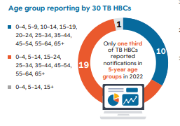
Age-group reporting
❶
❷
❸
❹
0 - 4 years
5 - 9 years
10-14 years
15-19 years
*
*TB HBCs TB high burden countries
Roadmap towards ending TB in children and adolescents, third edition. Geneva: World Health Organization; 2023. Licence: CC BY-NC-SA 3.0 IGO.
Notes:
Before we leave the data topic, I need to point out that WHO recommends that reporting of child TB indicators is broken down by five- year age groups: 0-4; 5-9; 10-14; and 15-19 years even though our preceding slides do not follow this recommendation.
This is a common situation also globally. By the end of 2022, only one third of high TB burden countries reported their data according to these five-year age-groups. It is important that all of us will transition to this practice.

Slide 29
Conclusion and Summary of key learning points

Slide 30
Conclusion: summary of key learning points
It is important to appropriately record and report children and adolescents at each stage of TB care and prevention.
It is important for NTPs to use key programmatic indicators to monitor and evaluate child and adolescent TB care activities.
NTPs should support health facilities to ensure that tools for recording and reporting are available.
Health facilities should analyse their own data to create opportunities for quality improvement.
Notes:
It is important to appropriately record and report children and adolescents at each stage of TB care It is essential to keep all the registers completely and correctly filled-in, including information on treatment outcomes. It is important for NTPs to identify key programmatic indicators that can be used to evaluate child and adolescent TB care activities. NTPs should support health facilities to ensure that tools for adequate recording and reporting are present at each health facility and that healthcare workers adequately understand how to analyse their own data to create opportunities for quality improvement.

Slide 31
References
Management of Tuberculosis: A Guide to Essential Practice. Paris: The Union; 2019. 146p. Available from: https://theunion.org/technical-publications/management-of-tuberculosis-a-guide-to-essential-practice
WHO TB Knowledge Sharing Platform: https://www.tbksp.org
WHO operational handbook on tuberculosis. Module 5: management of tuberculosis in children and adolescents. Geneva: World Health Organization; 2022. License: CC BY-NC-SA 3.0 IGO.
Open WHO. Management of tuberculosis in children and adolescents – programmatic considerations. World Health Organization, Geneva, 2024 https://openwho.org/courses/TB-child-adolescent-programmatic
Roadmap towards ending TB in children and adolescents, third edition. Geneva: World Health Organization; 2023 https://www.who.int/publications/i/item/9789240084254
Global laboratory initiative. The handbook, Global edition. Adelaide: SA Pathology; 2013. 88p.

Slide 32
Challenge your knowledge

Slide 33
Quiz question 1
Which of the following statements regarding recording and reporting of children screened and diagnosed with TB, is TRUE?
It is not important to record all children and adolescents with presumptive TB in the presumptive TB register because they will be recorded in the TB laboratory register when their samples are taken for diagnostic evaluation.
Only children and adolescents whose treatment has been interrupted for more than two months should be reported as lost to follow-up.
Children and adolescents who have been previously treated for TB for less than one month should be classified as newly diagnosed patients.
Children who have been transferred to a health facility during the course of their treatment should not be recorded in the TB treatment register because their records exist at the health facility where they were initiated on TB treatment.

Slide 34
Quiz question 1 - answer
Which of the following statements regarding recording and reporting of children screened and diagnosed with TB, is TRUE?
It is not important to record all children and adolescents with presumptive TB in the presumptive TB register because they will be recorded in the TB laboratory register when their samples are taken for diagnostic evaluation.
Only children and adolescents whose treatment has been interrupted for more than two months should be reported as lost to follow-up.
Children and adolescents who have been previously treated for TB for less than one month should be classified as newly diagnosed patients.
Children who have been transferred to a health facility during the course of their treatment should not be recorded in the TB treatment register because their records exist at the health facility where they were initiated on TB treatment.

Slide 35
Quiz question 2
Which of the following statements regarding the use of data generated from health facility recording and reporting tools, is TRUE?
The use of age-disaggregate data is desirable but not critical in the evaluation of district or provincial performance in child and adolescent TB programming.
The analysis of routinely collected data to evaluate and improve the performance of TB care activities can only be carried out the district or provincial level.
In the monitoring of treatment outcomes for children and adolescents, it is desirable but not critical to have treatment outcomes disaggregated by HIV status.
The use of data disaggregated by health facility is important in evaluating district or provincial level performance for any TB indicator.

Slide 36
Quiz question 2 - answer
Which of the following statements regarding the use of data generated from health facility recording and reporting tools, is TRUE?
The use of age-disaggregate data is desirable but not critical in the evaluation of district or provincial performance in child and adolescent TB programming.
The analysis of routinely collected data to evaluate and improve the performance of TB care activities can only be carried out the district or provincial level.
In the monitoring of treatment outcomes for children and adolescents, it is desirable but not critical to have treatment outcomes disaggregated by HIV status.
The use of data disaggregated by health facility is important in evaluating district or provincial level performance for any TB indicator.

